Slide 1

Last-Stage Drone Delivery
Matthew Conchar, Charles Kawalski, Chris Kachler, Jeff Martino, Austin Lowey
Advised by: Dr. Kevin Connington
“Developing innovative delivery solutions that are safe, reliable, and timely for urban environments.”

Slide 2
Outline
Project Statement and Goals
Market and Stakeholder Research
Concept Generation and Selection Process
Major Issues and Technical Analysis
Budget and Project Plan
Notes:
Chris - cut down a bit?

Slide 3
Project Statement
“Develop a system capable of completing package delivery to a residential balcony in an urban area via quadcopter drone, which does not come within 5 feet of the balcony to prevent human interference and maintain drone and human safety. The system should be able to handle packages weighing up to 5 pounds with dimensions that are within Amazon’s definition of a large standard-size package of 18’’x 14’’x 8’’. This task will be completed while considering current FAA Drone Laws and Regulations, with emphasis on the maximum drone flight height regulation of 400 feet and a standard balcony railing height of 36’’.”
Notes:
Chris - cut down a bit?

Slide 4
Motivation & Goals
Motivation
Potential in Drone Delivery Technology
Delivering packages safely and quickly
Design and build a prototype
Goals
Functioning prototype
Pride in the work
Grow as Engineers
Notes:
Chris

Slide 5
Outline
Project Statement and Goals
Market and Stakeholder Research
Concept Generation and Selection Process
Major Issues and Technical Analysis
Budget and Project Plan
Notes:
Chris - cut down a bit?

Slide 6
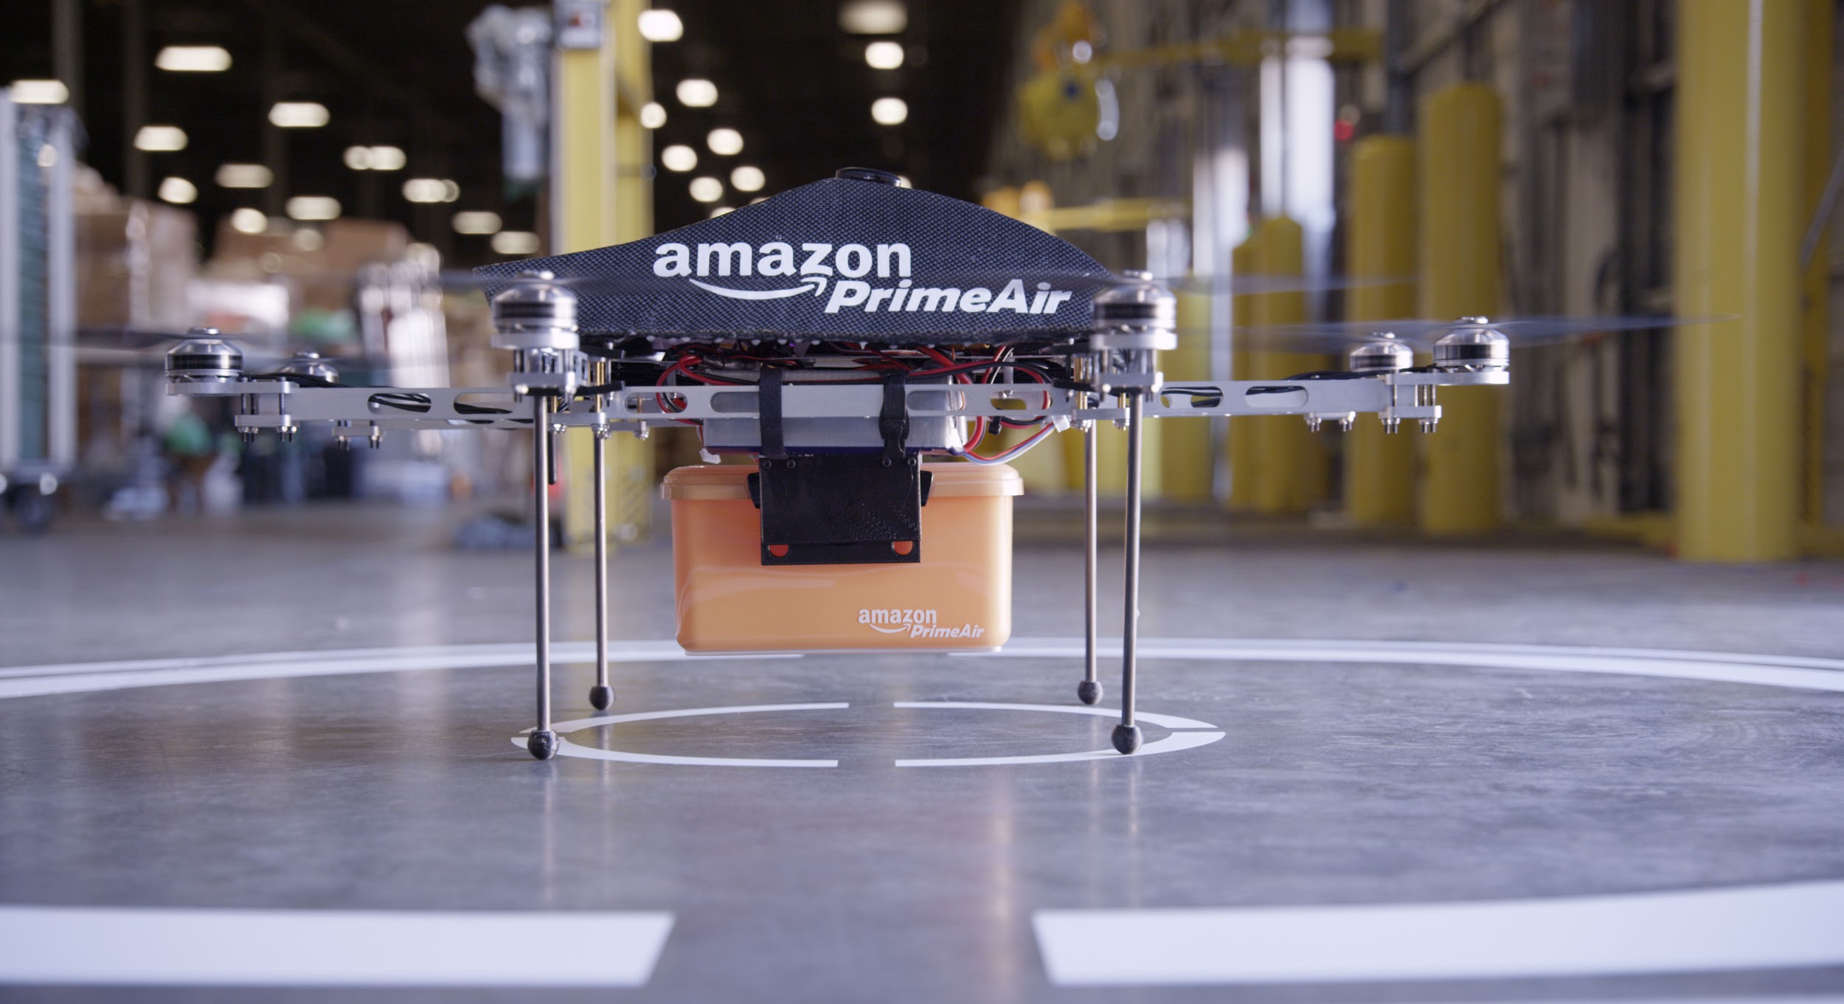
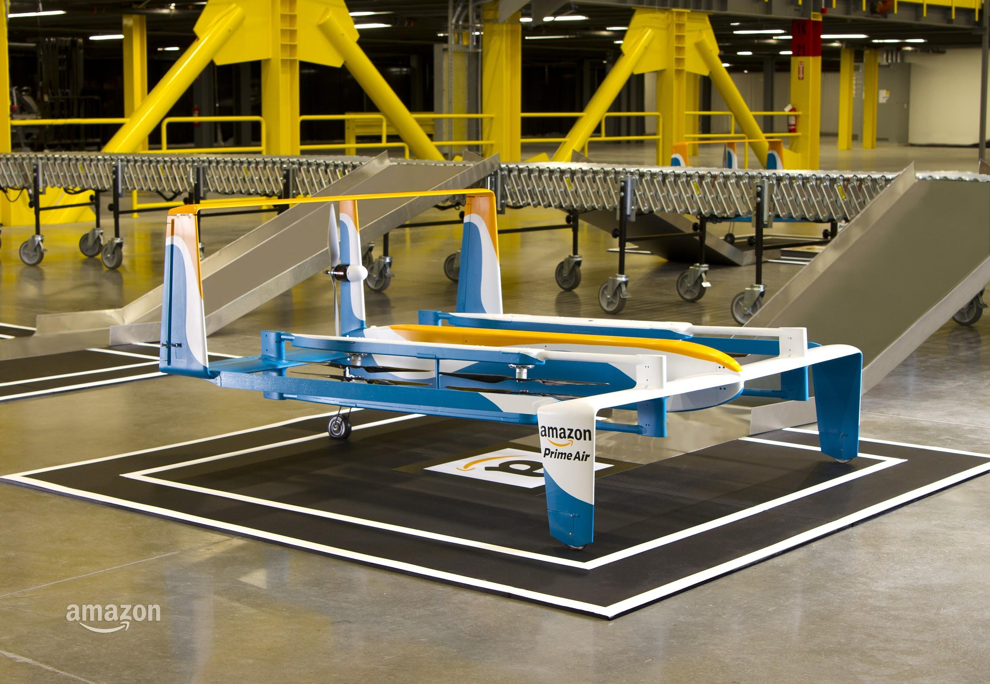
Current State of the Art: Drone-Side
Multi-Rotor
Fixed-Wing
VS
Advantages
Nimble in cornering
Ability to hover
Ability to change y-position readily
Uses
High-Density urban environments
Advantages
Efficient in long flight
Ability to operate on gas power
Uses
Lower-Density residential environments
Notes:
Matt

Slide 7
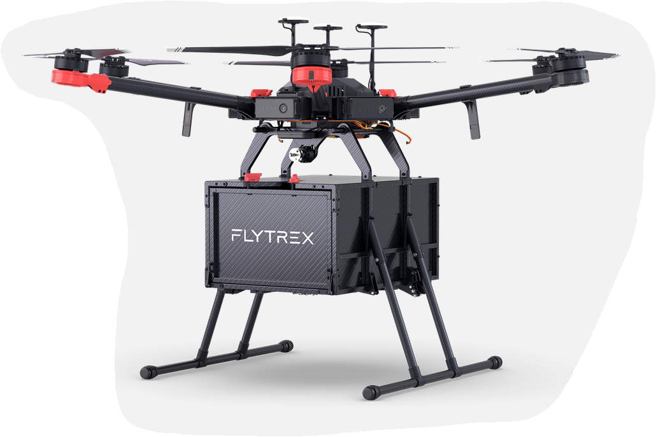
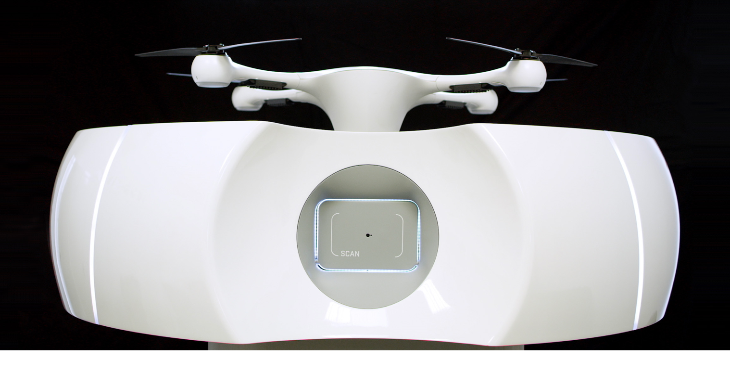
Current State of the Art: Autonomous Delivery
Matternet (Switzerland)
“Dropbox” for package security
Flytrex Cloud-Based Drone (Iceland)
Control Center App
Scheduling Routes
Various Drop Options
Statistics Reporting
Notes:
Matt

Slide 8
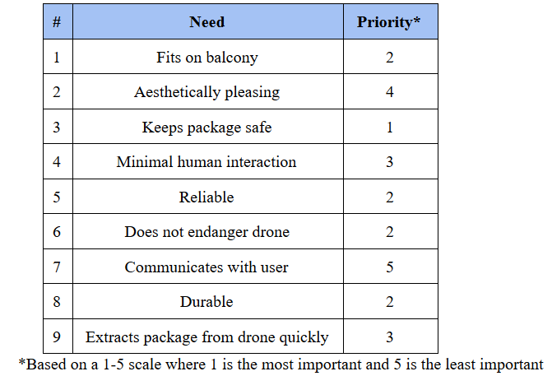
Stakeholder Needs
High Priority Needs
Human, drone, and package safety
Reliable and Durable
Medium Priority Needs
Autonomous
Fast operational speeds
Low Priority Needs
Aesthetically pleasing
Consumer Communication
Notes:
Blake
Survey responses
Needs are subject to change based on survey we sent out, matt will discuss in more detail during the concept selection
Most are customer needs, also need to take into account other stakeholder needs like the drone operator company
Operational speed and drone safety are drone operator needs and need to be a fairly high priority to maintain coordination and cooperation

Slide 9
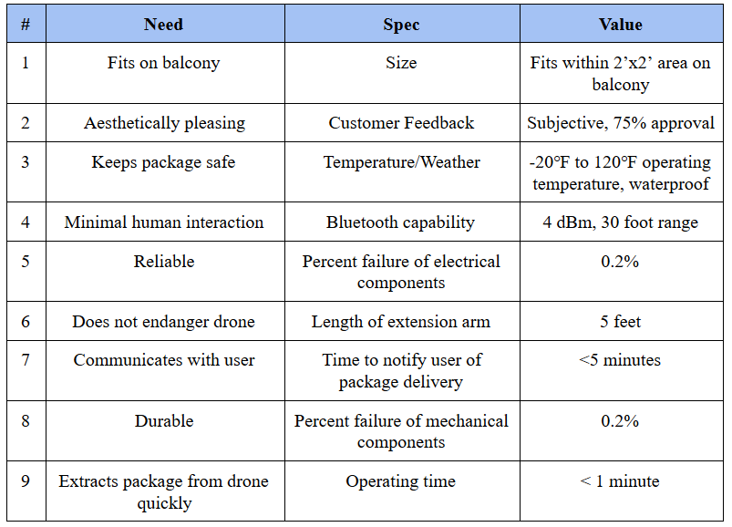
Design Specifications
Notes:
Blake - highlight key specs
Only go over high priority specs: metric to keep package safe, metric to minimize drone danger, minimize human interaction and increase human safety
Durability and reliability - minimize mechanical and electrical failures, also attributed to waterproofing device, number of uses

Slide 10
Outline
Project Statement and Goals
Market and Stakeholder Research
Concept Generation and Selection Process
Major Issues and Technical Analysis
Budget and Project Plan
Notes:
Chris - cut down a bit?

Slide 11
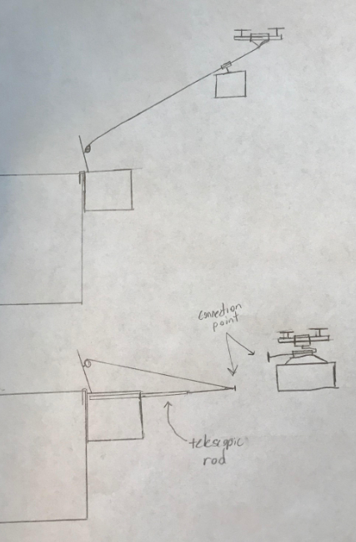
Concept 1 - Zip Line System
Advantages
Fits all balcony types
Aesthetically pleasing
Disadvantages
Mounted outside of balcony
Problem of drone stability while delivery
Connection Points
Telescopic Rod
Side View
Notes:
Jeff - make text in photo clearer

Slide 12
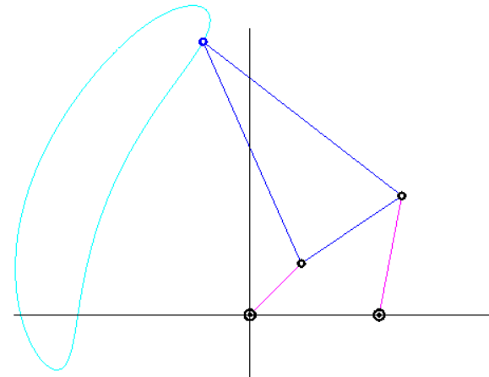
Concept 2 - Four-Bar Linkage
Pick Up Point
Advantages
Fits most balcony types
Simple design
Disadvantages
Not discreet
Mounted outside balcony
Balcony
Railing
Side View
Notes:
Jeff - I think we should have the path definition parallel to the ground in all cases. If not, people will struggle to follow. MAKE CLEAR WHERE BALCONY IS

Slide 13
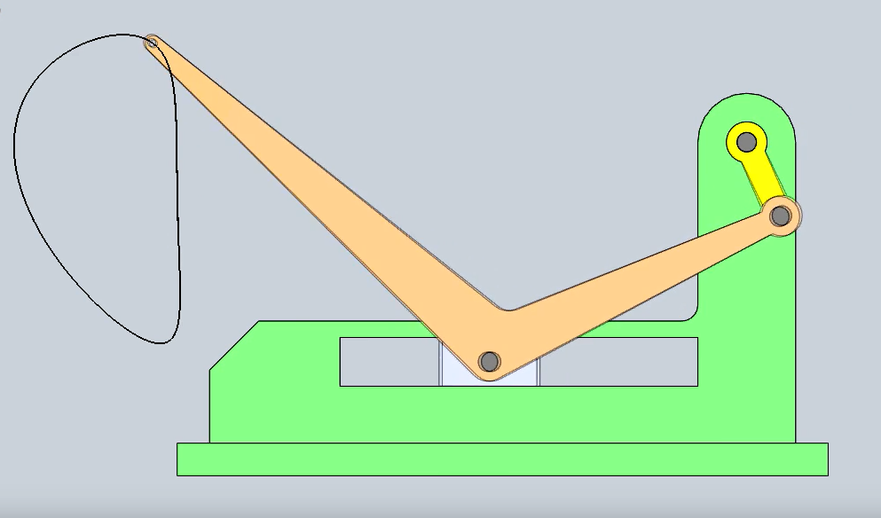
Concept 3 - Slider Mechanism
Pick Up Point
Advantages
Fits most balcony types
Package safety
Disadvantages
Mounted outside balcony
Not aesthetically pleasing
Balcony Railing
Side View
Notes:
Jeff - MAKE CLEAR WHERE BALCONY IS

Slide 14
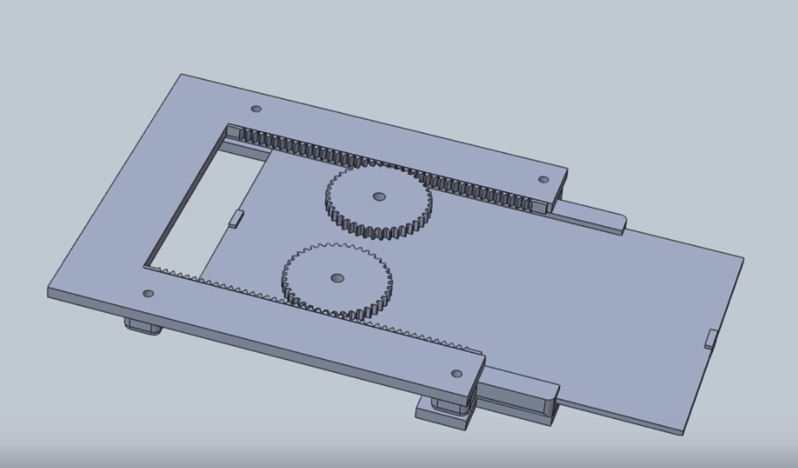
Concept 4 - Gear Train
Advantages
Straight-line motion parallel to ground
More discreet
Safer
Compact (telescopic)
Disadvantages
Complex gear design
Package placed here
Notes:
Austin - add basket drawing onto end of model

Slide 15
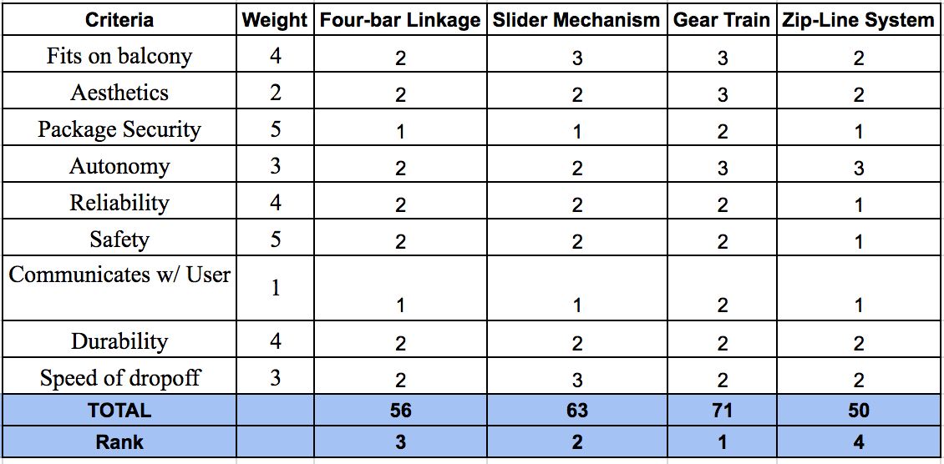
Concept Selection
Notes:
Matt Conchar

Slide 16
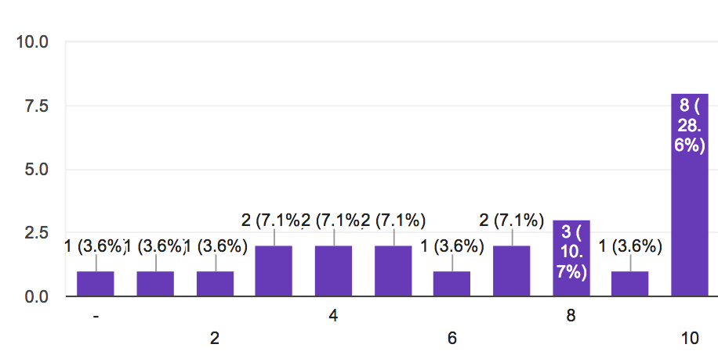
How much do you value the current look of your balcony?
>40% of customers
Notes:
Matt

Slide 17
Outline
Project Statement and Goals
Market and Stakeholder Research
Concept Generation and Selection Process
Major Issues and Technical Analysis
Budget and Project Plan
Notes:
Chris - cut down a bit?

Slide 18
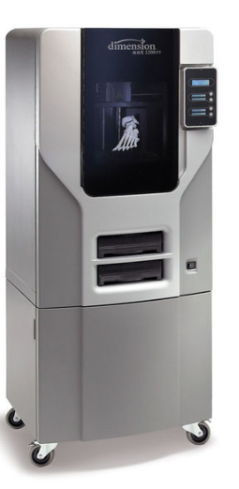
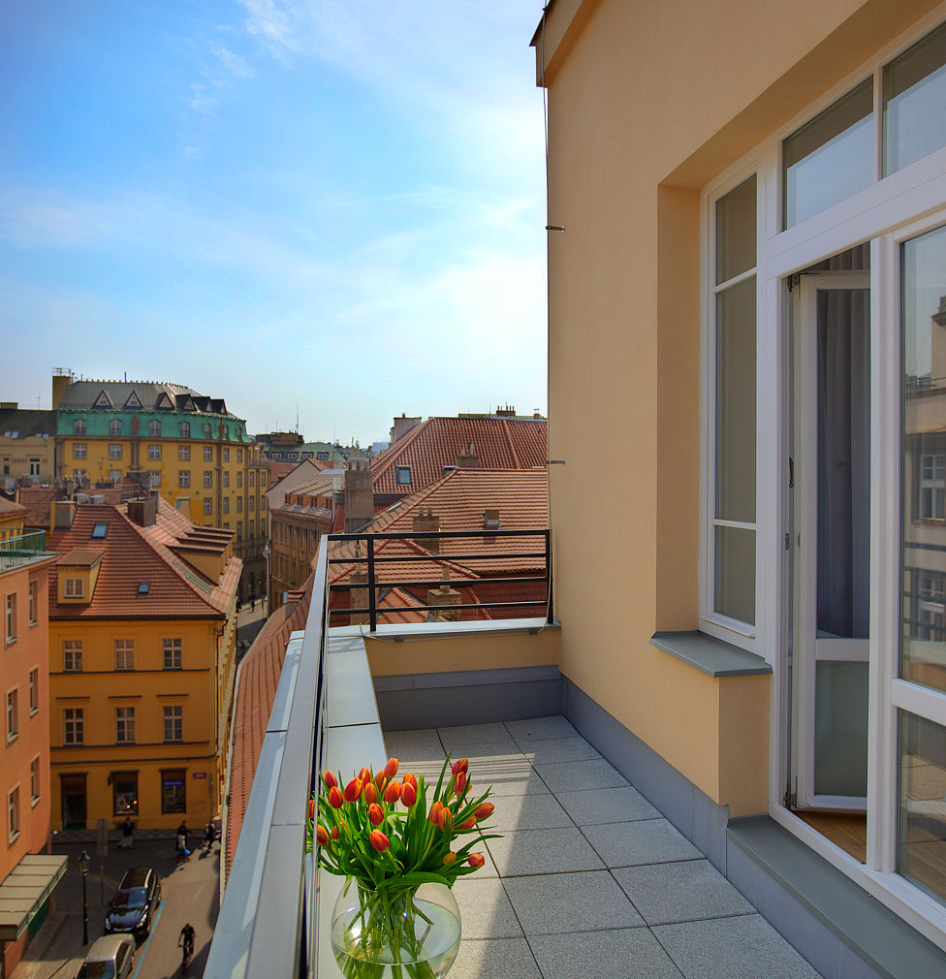
Major Issues
Design and Analysis
Drone Proximity
Safety
Aesthetics/Discretion
Prototyping and Experimentation
Most complicated system - Gear train
Start designing early
Leave time for testing/troubleshooting
Fabrication method
Machined to use strength of metals
Prototype - Machined gears & FDM smaller scale overall model
Dimension 1200es
Build volume
Notes:
Austin - people will probably ask questions about safety. Discuss thoroughly & Be prepared to answer questions about it

Slide 19
Future Technical Analysis for Phase II
Gear train
Most complex aspect of design
Cantilever analysis
Analyzed especially at full extension
FEA
Telescopic assembly - Compact
Determine footprint and refine spec’s
Sensors
Notes:
Austin - know what other spec’s need to be refined in case someone asks

Slide 20
Outline
Project Statement and Goals
Market and Stakeholder Research
Concept Generation and Selection Process
Major Issues and Technical Analysis
Budget and Project Plan
Notes:
Chris - cut down a bit?

Slide 21
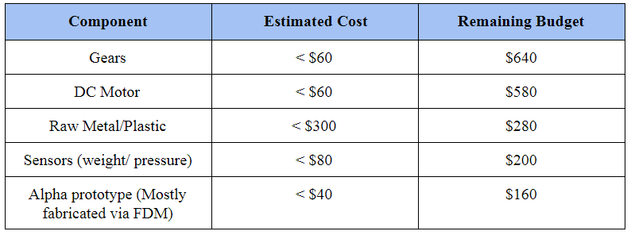
Budget
Flexibility
Change/variations in the design
Notes:
Chris

Slide 22
Project Plan
Phase I | Phase II | Phase III
Project Statement | Alpha Design | Finalize Technical Analysis and Testing
Product Research | CAD Model | Design Refinement
Four Viable Concepts | Website Shell | Finalize Design
Concept Decision | Preliminary Simulation Testing | Order Materials
Notes:
Blake
MEchanical design of telescopic extension arm and CAD of mechanism will be the bulk of phase II

Slide 23
Summary
Potential for Drone Delivery in urban areas
Needs to be safe and reliable
Device sits in balcony
Extends arm and pad for drone
Retracts back onto balcony
Gear train for horizontal movement, telescopic to save space
What’s next in Phase II?
Develop gear train design
Cantilever analysis
Determine optimal footprint

Slide 24
Thank you for time and attention!
Questions/Comments/Concerns?
Notes:
Blake - discussion or conclusion

Slide 25
Additional Slides
Notes:
Chris - cut down a bit?

Slide 26
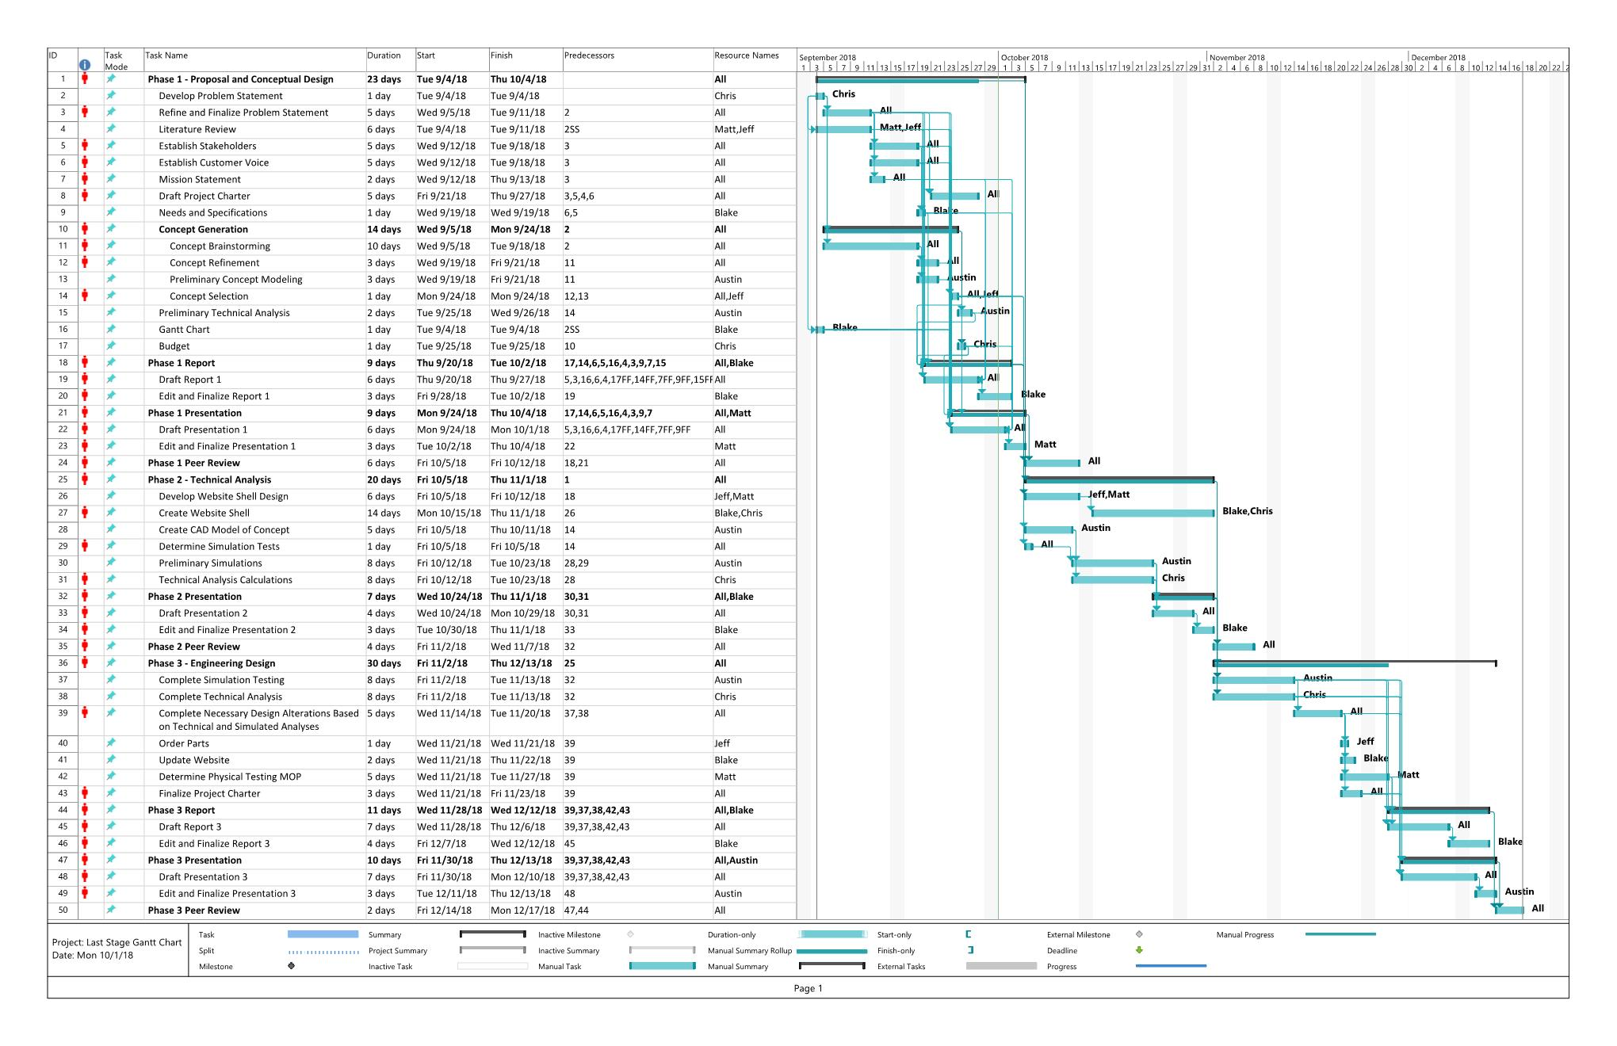
Gantt Chart

